Slide 1
Overview of Software Engineering
From scratches to end-user softwares
Thai
04/2020

Slide 2
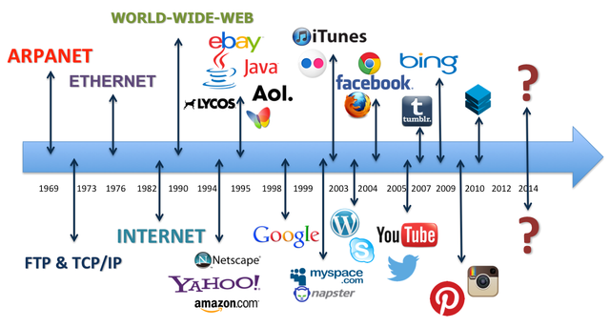
Introduction
Notes:
https://www.seekmomentum.com/blog/manufacturing/the-evolution-of-industry-from-1-to-4

Slide 3
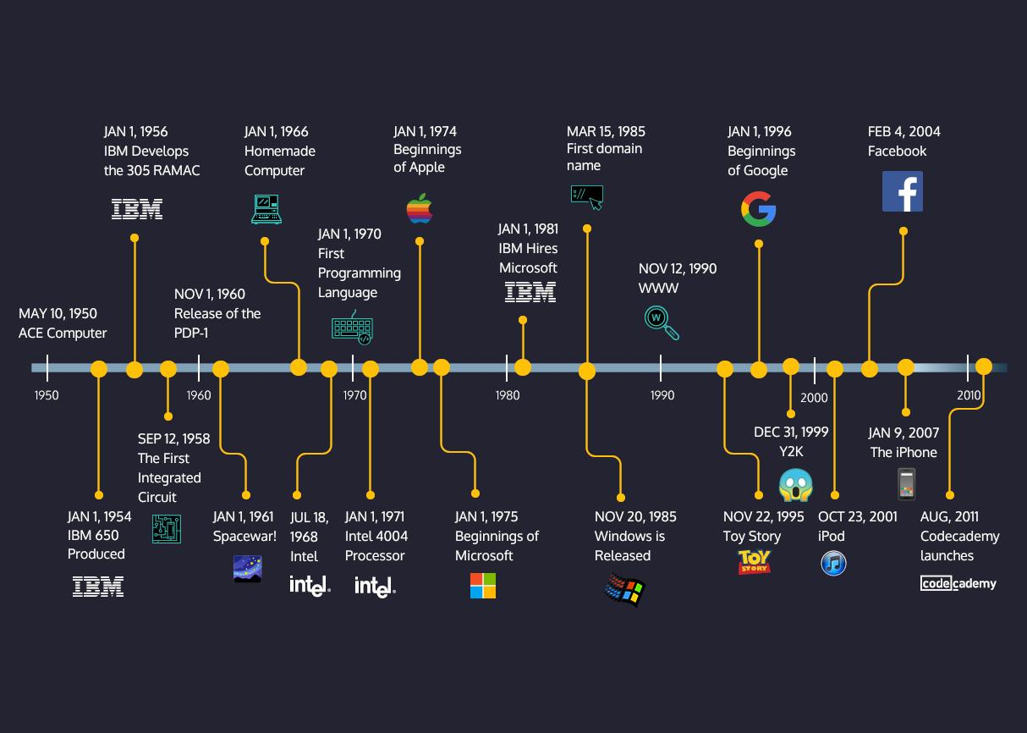
Introduction

Slide 4
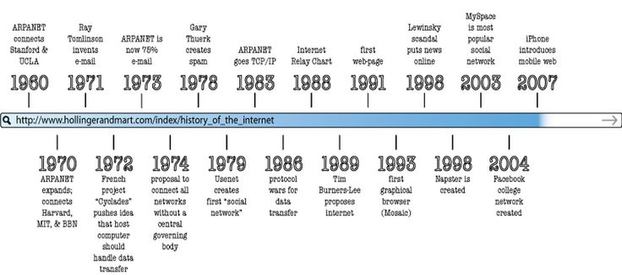
Introduction

Slide 5
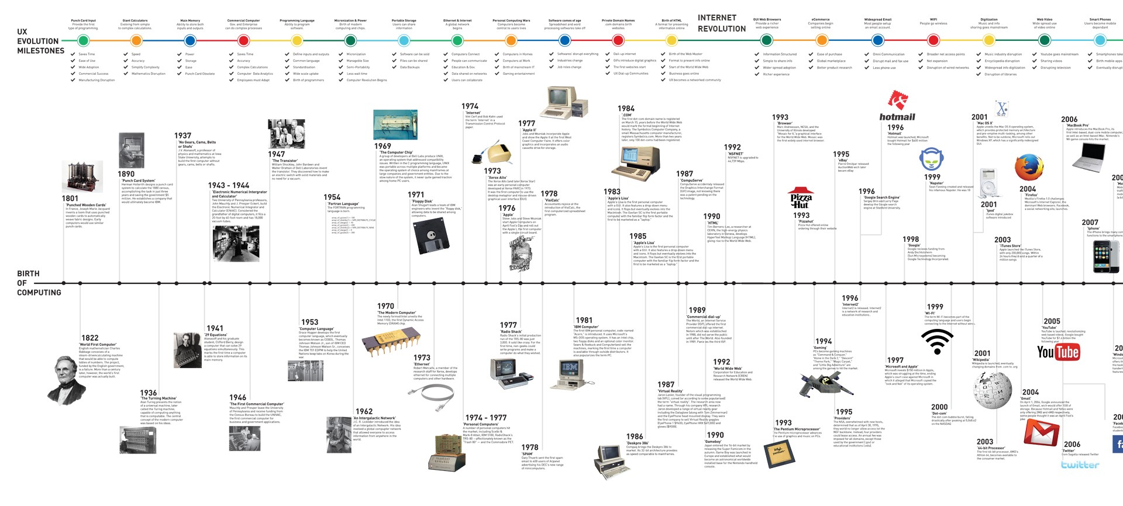
Introduction

Slide 6
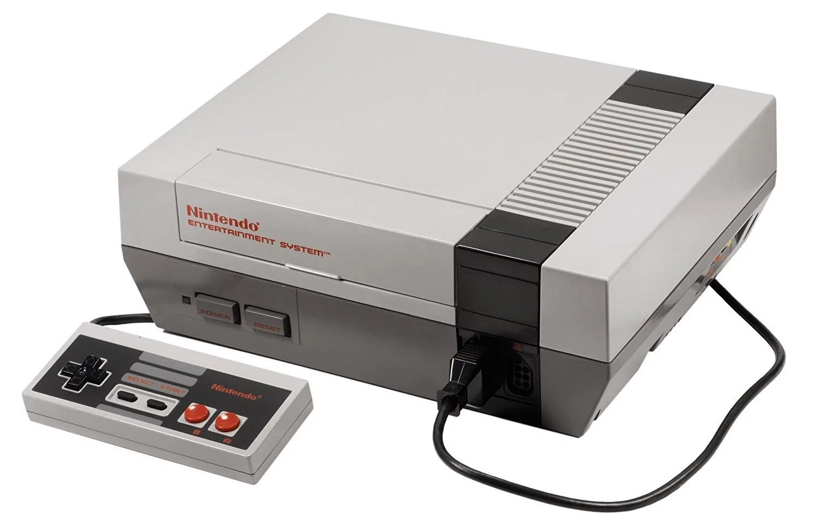
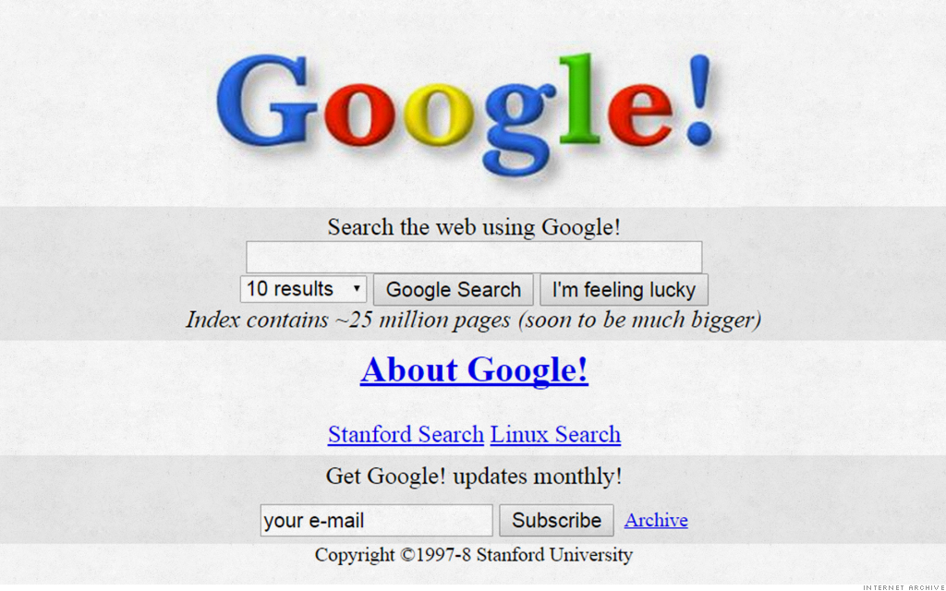
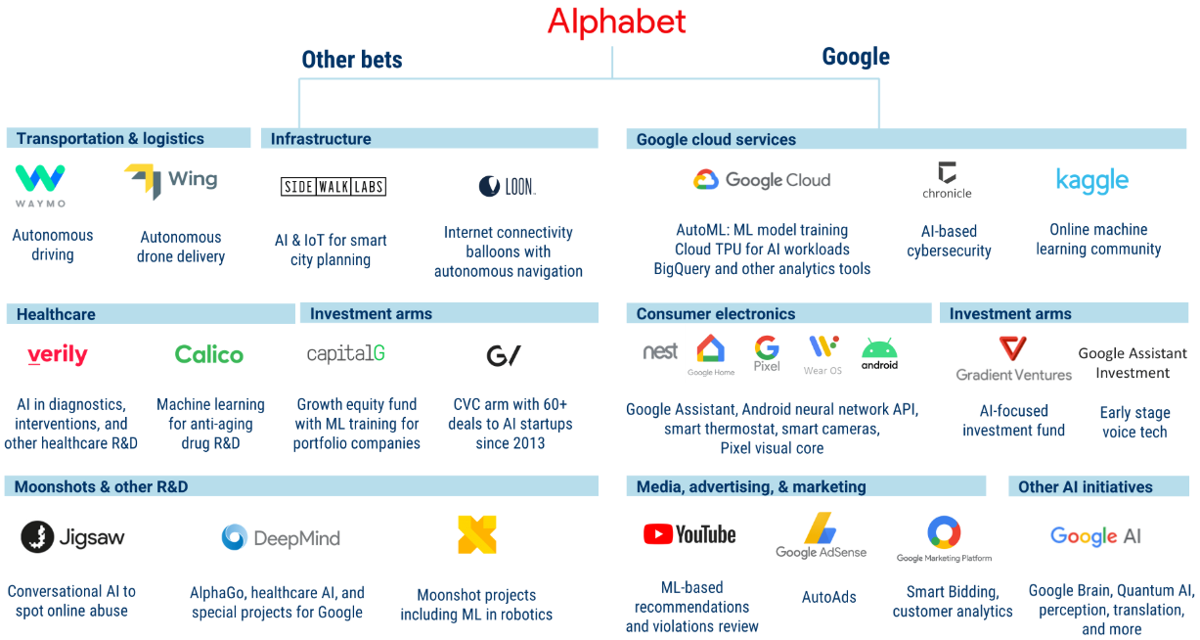
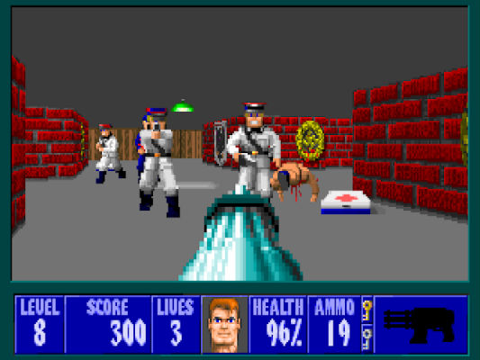
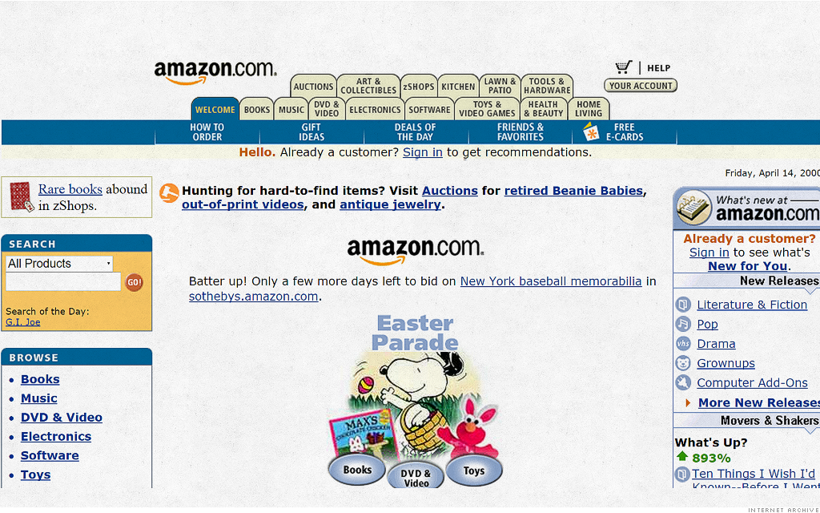

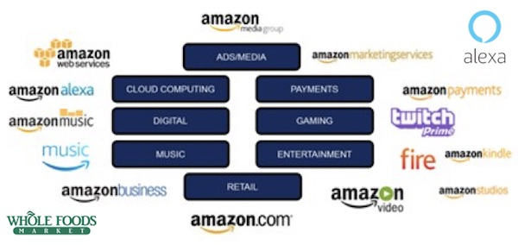
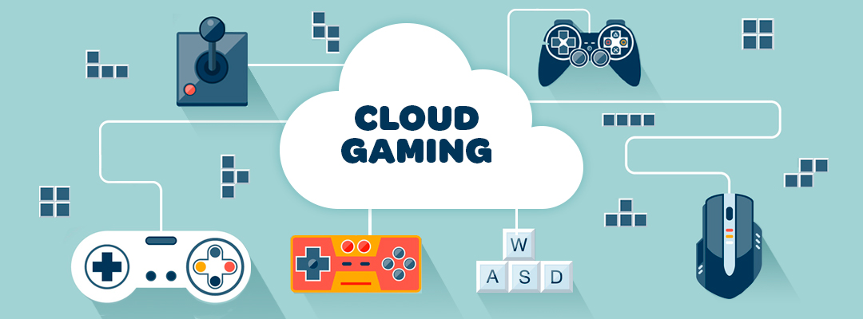
Introduction

Slide 7
Introduction
Software engineering is the study of how software systems are built, including topics such as project management, quality assurance, and software testing
Software engineering applies engineering approaches to the development of software. Aiming at the creation of economical, reliable, efficient software that works on real machines.
Notes:
The larger context of software
– Business, society, policy
Building good software, organizing software projects
– Development teams, customers, and users
– Process, requirements, estimation, management, and methods
Computer Science is the study of how computers work, mostly from the theoretical and mathematical perspective

Slide 8
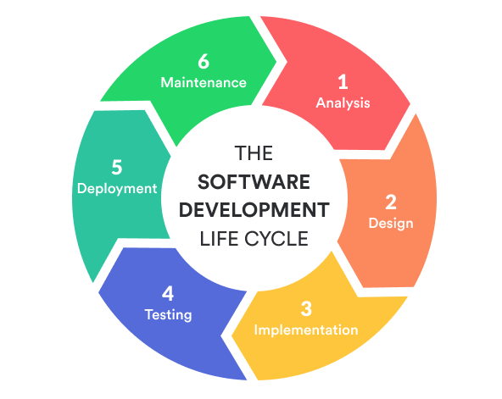
TOC
Processes
Requirements
Design
Implementation
Testing
Delivery
Maintenance
Example
Conclusion

Slide 9
Phases in software developments
Process
Learn about software development processes commonly used in industry, including Traditional approaches (Waterfall and Spiral) and modern Agile approaches (XP, TDD, and Scrum)
Requirements
Learn how requirements help customers and software engineering teams communicate. Learn about the process of gathering and validating requirements, and how to create high quality user stories as specifications.
High Level Design
Learn about high level design guidance to help improve the evolvability and maintainability of software systems over time. Take a closer look at abstraction, technical representations, APIs, REST, coupling and cohesion, and the SOLID design principles.

Slide 10
Phases in software developments
Low Level Design
Learn about low level design guidance for implementing software systems. Learn how and when to use the Singleton, Strategy, State, Facade, Decorator, MVC and MVP design patterns.
Implementation
Learn about advanced software construction topics in the context of software engineering, such as non-structural properties, static analysis and linters, automation, code smells, and refactoring.
Testing
Learn about the testing process for large-scale software systems. Deep dive into the intricacies of white box testing and coverage, black box testing and equivalence class partitioning, assertions and testability.
Delivery & Maintenance
Learn about the deployment process and maintain the QoS. Know how CI, CD help deliver software to clients as fast as possible and effortlessly.

Slide 11
Processes
Structure the diverse set of activities that are involved in building modern software systems, because our ultimate goal is to build a successful and maintainable system that will be used for years to come in the future.
What are we actually trying to build
Who are the people involved in this whole software development process
Tech teams: Manager, Developers, Q/A, DevOps
Business teams: Sales, Marketing, Support
Clients
How does the cooperation take place
When, we need a timeline to meet the shipment date.

Slide 12
Processes
Two categories:
Traditional approaches (Waterfall and Spiral)
Modern Agile approaches

Slide 13
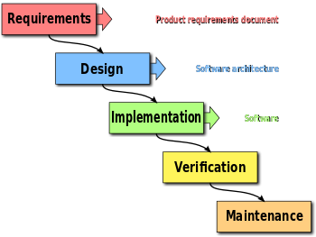
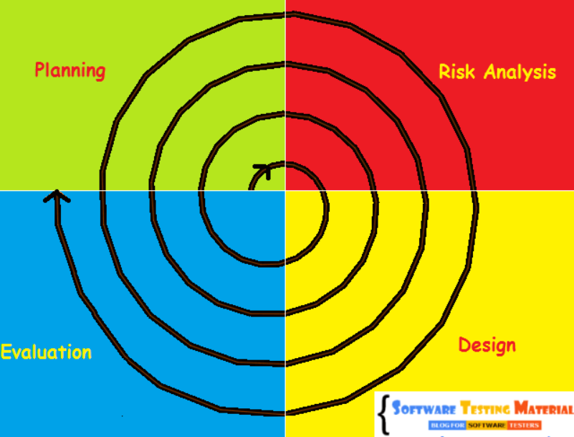
Processes
Traditional approaches (Waterfall and Spiral)

Slide 14
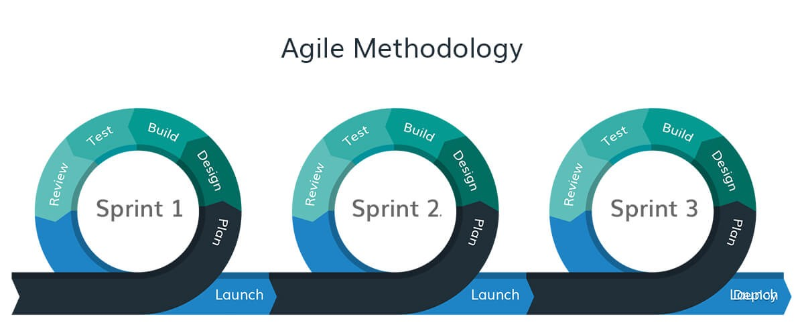
Processes
Modern Agile approaches
Favor individual interactions over processes and tools
Favoring working software over extensive documentation
Favor customer interactions over contract negotiations
Favor agility over planning

Slide 15
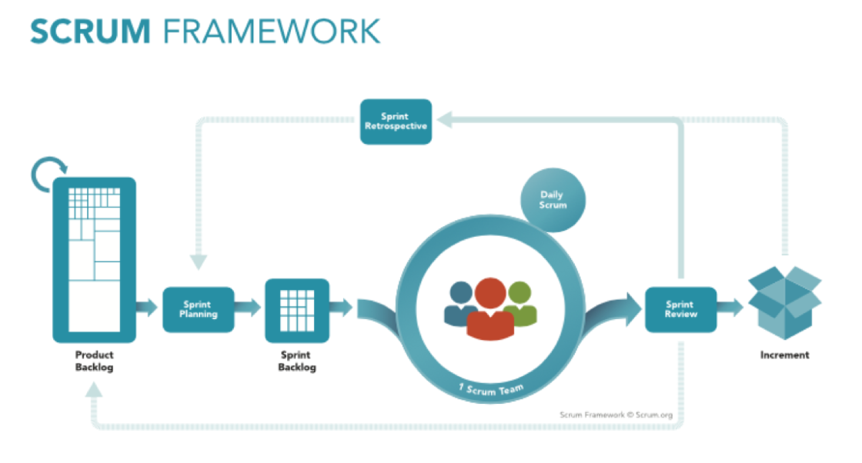
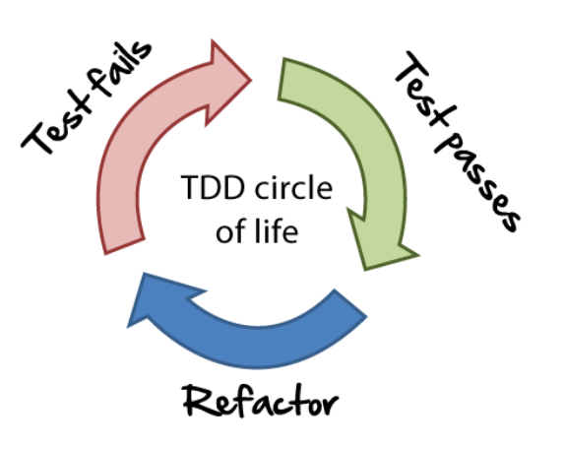
Processes
Modern Agile approaches
Agile frameworks:
Scrum - Lean startup
XP - Kanban
etc
Agile software development practices:
Backlogs - User story
Code review - Refactoring
TDD/BDD - CI/CD
Pair programming - Standup meeting
etc

Slide 16
Requirements
Requirements process
Requirement validations
User stories
INVEST guidelines
Decomposing user stories

Slide 17
Requirements
Requirements process
Requirement process
Functional requirements, i.e. as a user, I can see a list of all merchandise in the product list
Non-functional requirements, i.e. the quality of the system
Usability
Performance
Reliability
Scalability
Complexity
Testability
(optional) Design constraints, i.e. RGBD, budget, resources
Environmental constraints, i.e. the app must interact with third-party authentication
Preferences

Slide 18
Requirements
Requirements process
Requirement properties
Complete
Consistent
Precise
Concise
Requirement elicitation
Elicitation (figure out what actually to be built)
Analysis (and negotiation)
Reification (write out requirements using use cases)
Validation (with customer)
Reiterate the above cycle

Slide 19
Requirements
Requirement validations
Validation of requirements is made by technical teams to ensure the technical viability of requirements

Slide 20
Requirements
User stories
Requirements are described in user stories, which capture:
Role-goal-benefits
Limitations of features
Definition of done
Engineering tasks
Effort estimate

Slide 21
Requirements
INVEST guidelines
User stories should be
Independent
Negotiable
Valuable
Estimable
Small
Testable

Slide 22
Requirements
Decompose User Stories
User stories should be decomposed into:
Role
Goal
Benefit
Limitation
Notes
Cost
Definition of Done: check INVEST

Slide 23
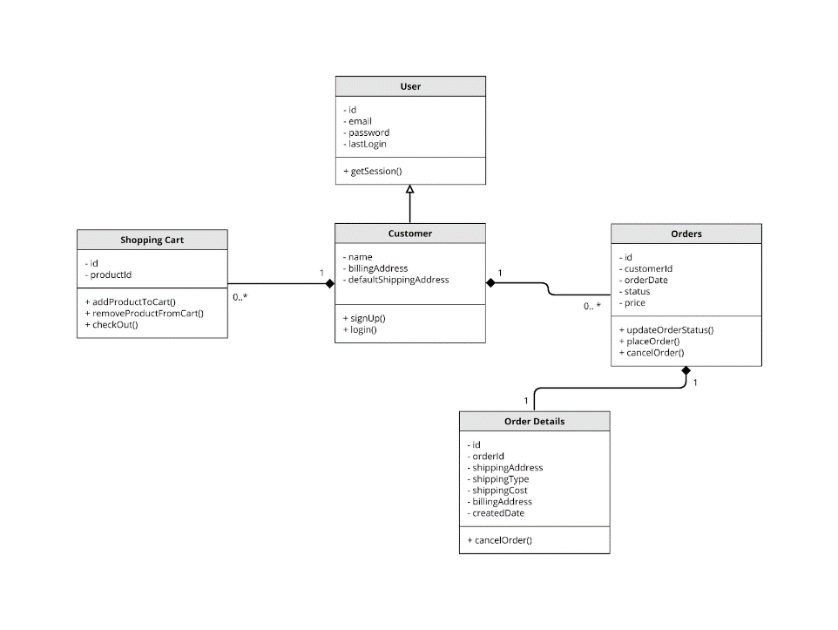
Requirements
Decompose User Stories
Translate user stories into design:
Find entities, link them, bind action, prototype: create graph of entities and their relations
Formalize, implement: change graph into UML diagram
Class diagram
Notes:
https://moqups.com/templates/diagrams-flowcharts/uml-diagrams/

Slide 24
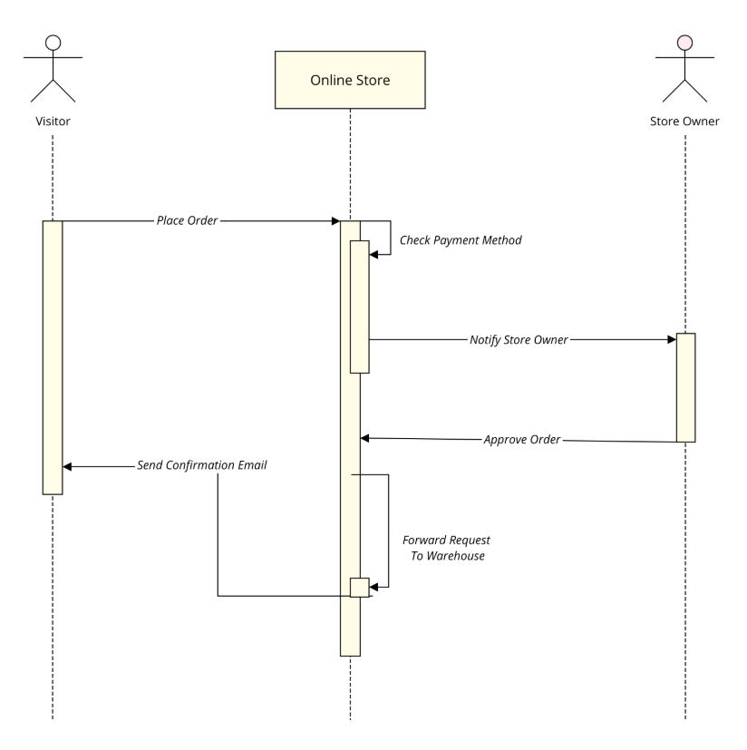
Requirements
Decompose User Stories
Translate user stories into design:
Find entities, link them, bind action, prototype: create graph of entities and their relations
Formalize, implement: change graph into UML diagram
Sequence diagram

Slide 25
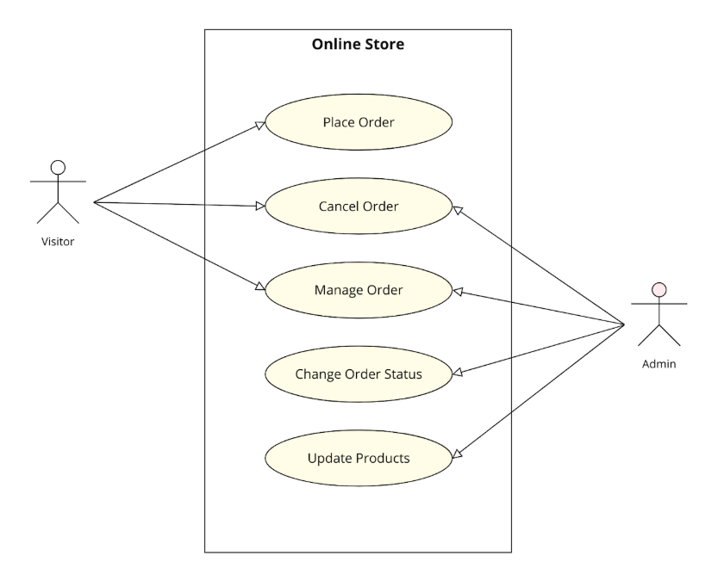
Requirements
Decompose User Stories
Translate user stories into design:
Find entities, link them, bind action, prototype: create graph of entities and their relations
Formalize, implement: change graph into UML diagram
Use case diagram

Slide 26
Software Design
Requirements are transformed into ready-for-implementation format
Software design document includes:
High level design: explains overall architecture
Low level design: exposes details of all components with terminologies for developers
Description of Classes, Methods, Properties
Design process
Requirements

Slide 27
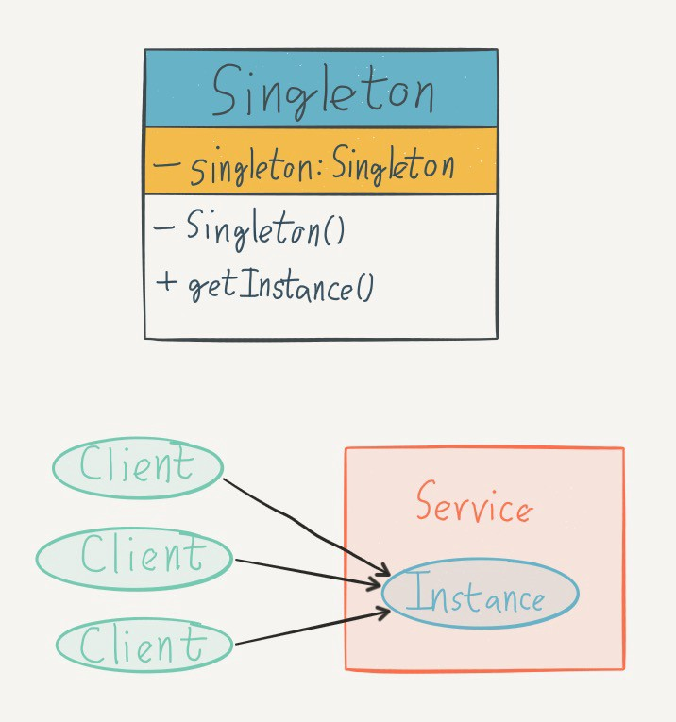
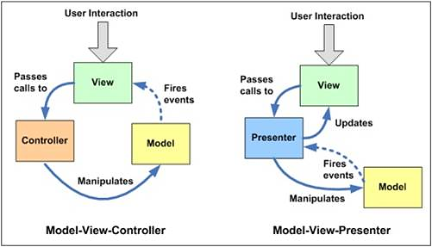
Software Design
Low-Level Design
Design Patterns (MVC, Singleton, Strategy, etc)

Slide 28
Software Design
High Level Design
HLD features overall architecture:
Can be a diagram
Uses non-technical to mildly technical terms (for administrators of the system)
Lists main components:
Languages, OS, hardwares
Bulding blocks/services (UI, backend, database)

Slide 29
Software Design
High-Level Design
Abstraction
Data abstraction
Control abstraction
Decomposition
Encapsulation
Constant change

Slide 30
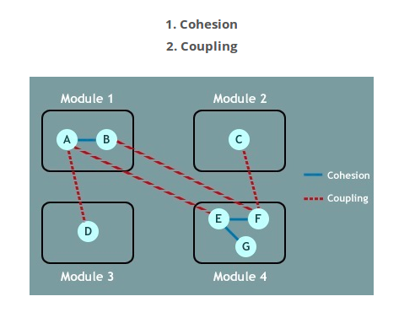
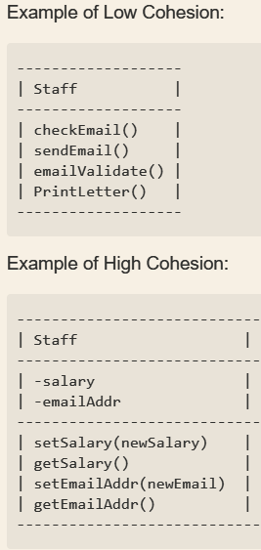
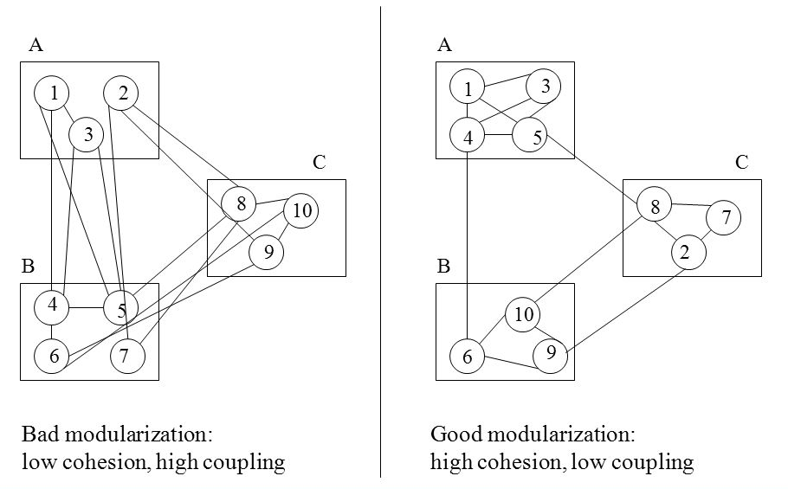
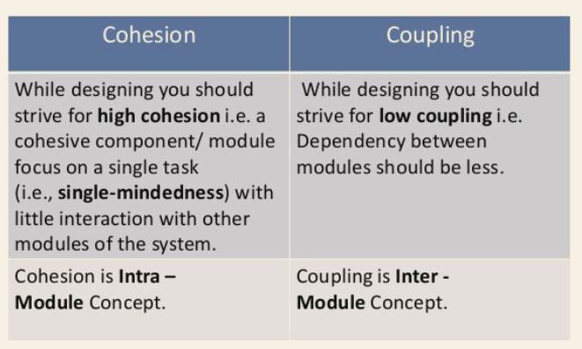
Software Design
High-Level Design
Design principles
Design for evolution
Coupling (low)
Cohesion (high)

Slide 31
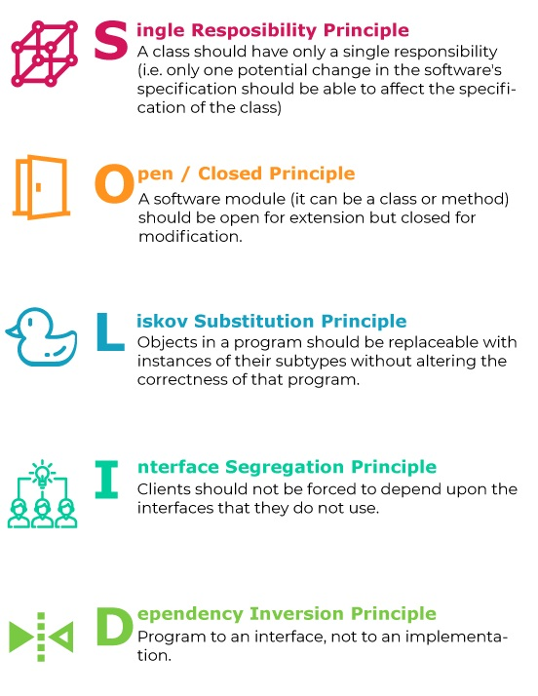
Software Design
High-Level Design
Design principles
SOLID guideline

Slide 32
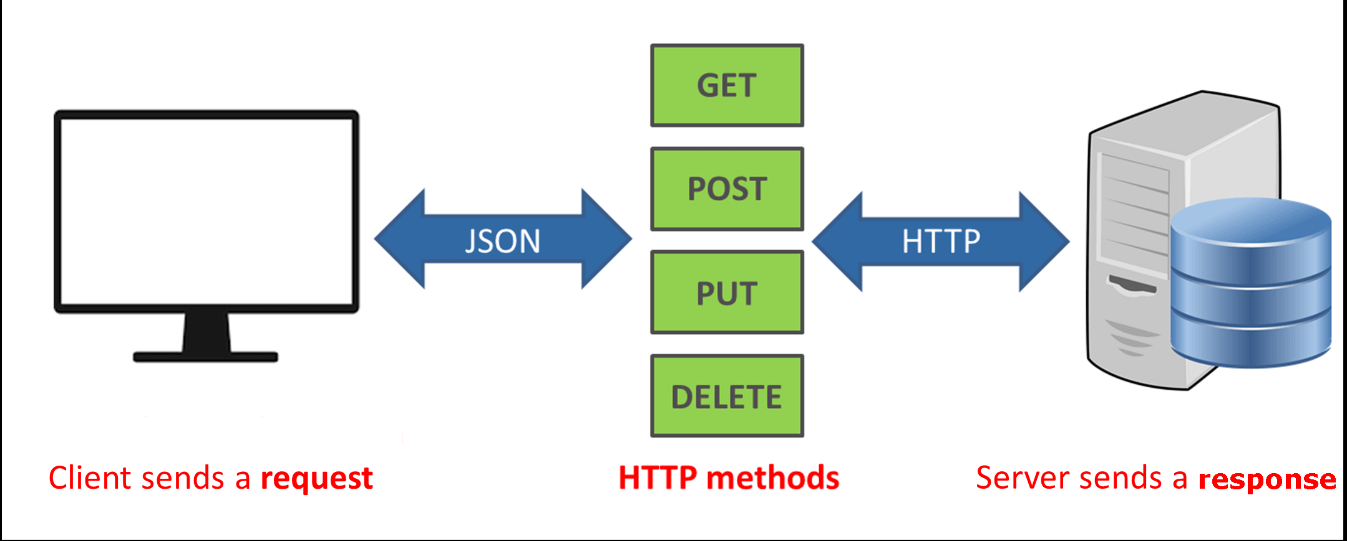
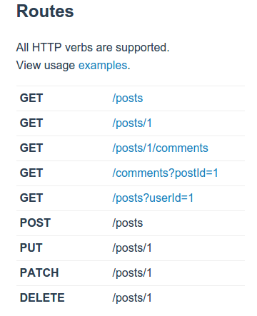
High-Level Design
RESTful API
Client–server
Stateless
Cacheable
Uniform interface
Layered system
Code on demand

Slide 33
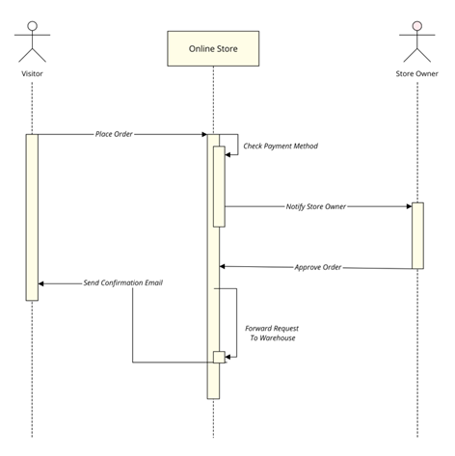
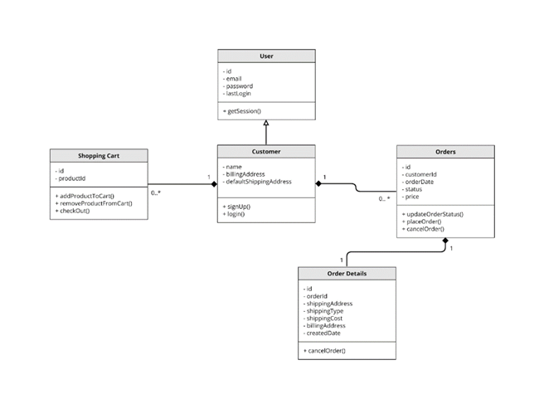
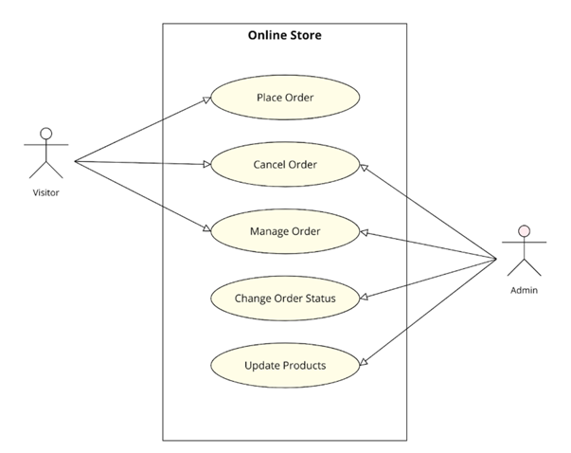
High-Level Design
Technical representation: UML
Database design
UI/UX

Slide 34
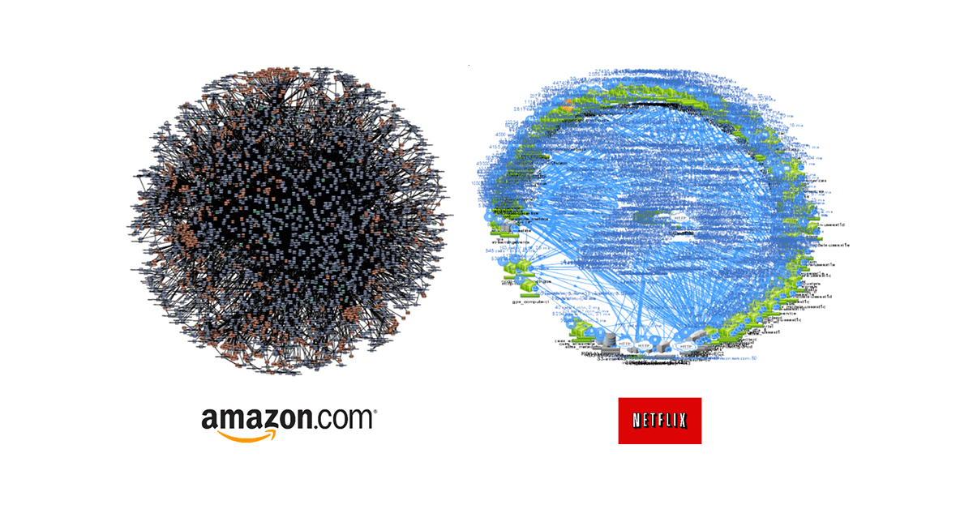
High Level Design >> Software Application Architectures
Microservices

Slide 35
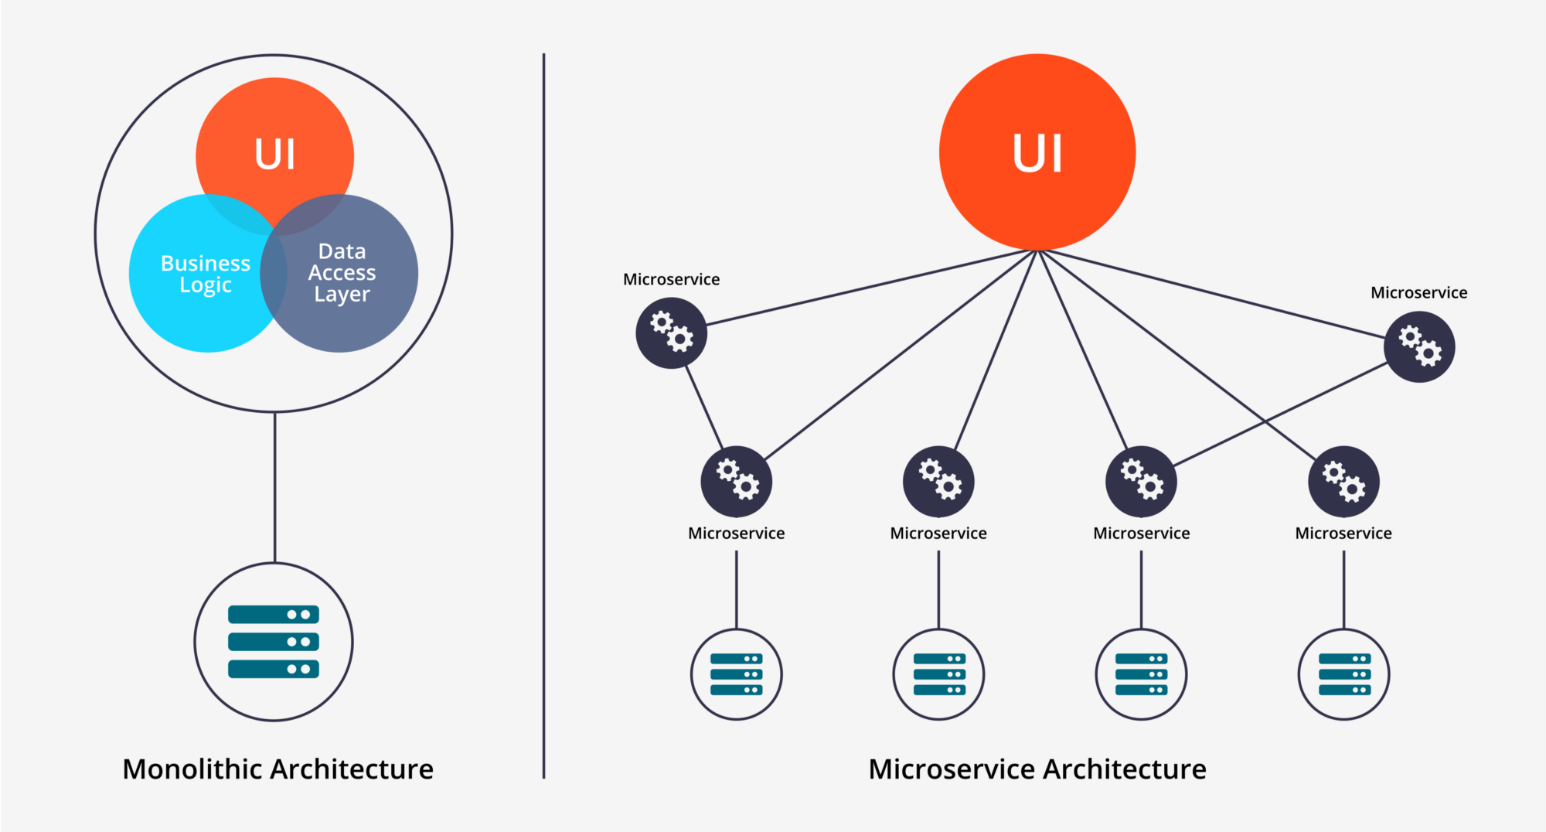
High Level Design >> Software Application Architectures
Microservices
Monolith - Microservices
Notes:
https://www.avsystem.com/blog/what-is-iot-architecture/

Slide 36
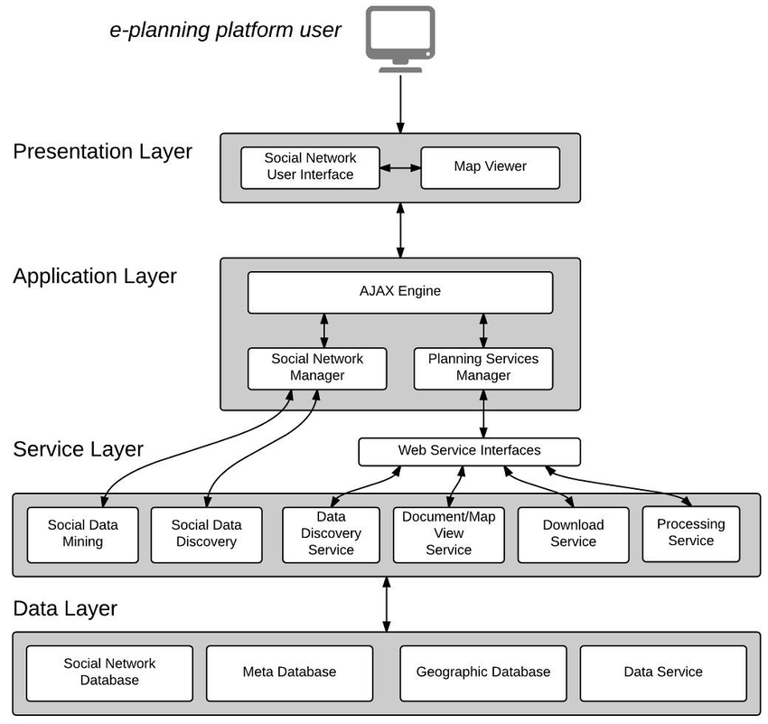
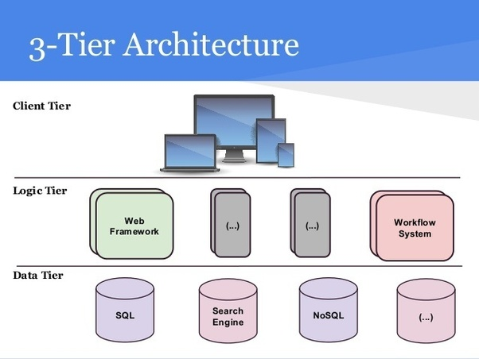
High Level Design >> Software Logic Architectures
Multitier architectures
Three-tier architecture
Four-tier architecture
Notes:
https://www.avsystem.com/blog/what-is-iot-architecture/

Slide 37
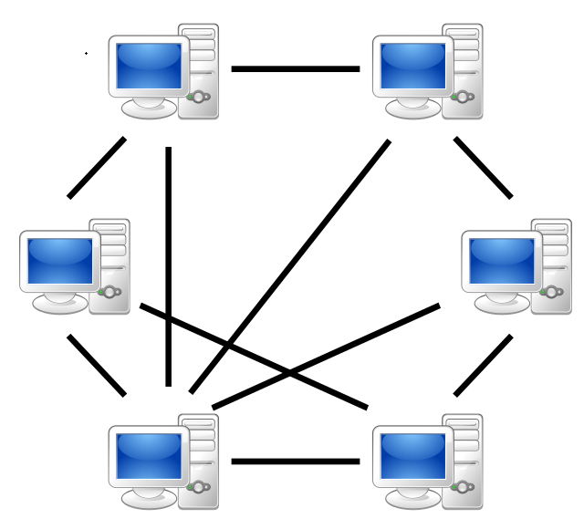
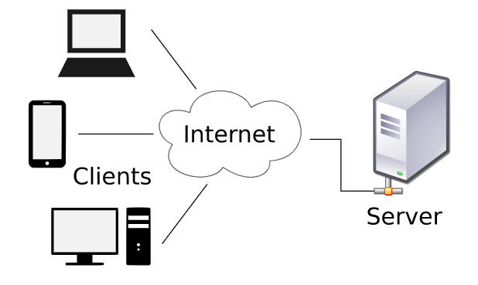
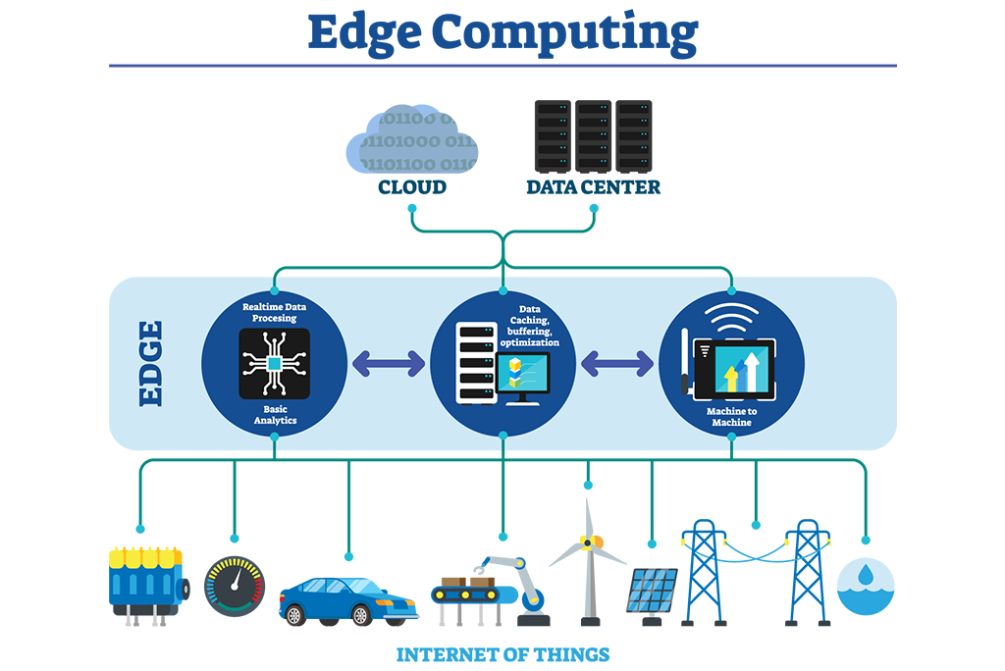
High Level Design >> System Architectures
Client-server model
Peer-to-peer model
IoT edge model
Notes:
https://www.avsystem.com/blog/what-is-iot-architecture/

Slide 38
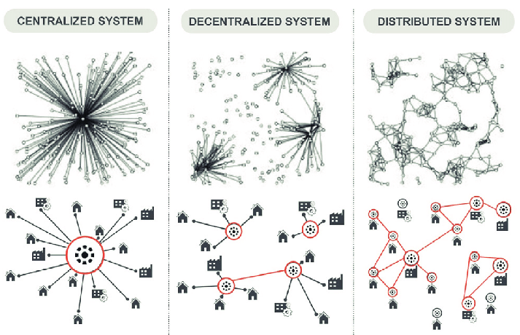
High Level Design >> System Architectures
Centralized vs Decentralization vs Distributed System
Bitcoin
Tor Network
Google Search
Torrent
Notes:
https://www.geeksforgeeks.org/comparison-centralized-decentralized-and-distributed-systems/

Slide 39
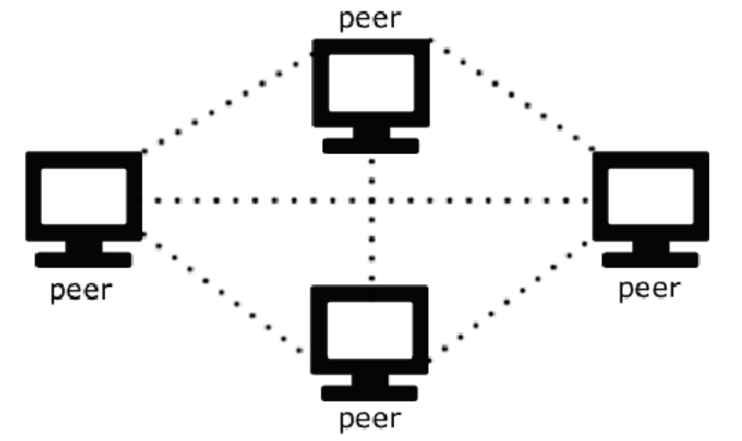
High Level Design >> System Architectures
Architectures of Centralized vs Decentralization vs Distributed System
Centralized system:
Client-server architecture
Decentralized system:
P2P architecture
Master-slave architecture
Distributed system:
Client-server architecture
P2P architecture
N-tier architecture

Slide 40
Implementation
Non-structural properties
Static Analysis & Linters
Automation
Code Smells
Refactoring

Slide 41
Implementation
Non-structural properties
Non-structural properties
Complexity
Performance
Security
Usability
Portability
Scalability
Readability
Clean code
Anti-pattern (deep nesting, bad naming…)

Slide 42
Implementation
Static Analysis & Linters
Static Analysis & Linters
Static vs Dynamic Analysis

Slide 43
Implementation
Automation
Automation:
Source control: git, svn
Dependency management: npm, pip
Build tools: ant, gradle, make
Test tools: jUnit, mocha
Test runners: Jenkins, TravisCI
Deployment: docker, bare-metal server, cloud

Slide 44
Implementation
Code Smells
Application-level smells
Duplicated code
Contrived complexity
Shotgun surgery: a single change needs to be applied to multiple classes at the same time.
Uncontrolled side effects
Variable mutations: very hard to refactor code since the actual value is unpredictable and hard to reason about.
Boolean blindness: easy to assert on the opposite value and still type checks.

Slide 45
Implementation
Code Smells
Class-level smells:
Large class
Feature envy
Inappropriate intimacy: a class that has dependencies on implementation details of another class
Refused bequest: a class that overrides a method of a base class in such a way that the contract of the base class is not honored by the derived class. See Liskov substitution principle.
Lazy class / freeloader: a class that does too little.
Excessive use of literals
Cyclomatic complexity: too many branches or loops; this may indicate a function needs to be broken up into smaller functions, or that it has potential for simplification.

Slide 46
Implementation
Code Smells
Class-level smells:
Downcasting: a type cast which breaks the abstraction model; the abstraction may have to be refactored or eliminated.
Orphan variable or constant class: a class that typically has a collection of constants which belong elsewhere where those constants should be owned by one of the other member classes.
Data clump: Occurs when a group of variables are passed around together in various parts of the program. In general, this suggests that it would be more appropriate to formally group the different variables together into a single object, and pass around only this object instead

Slide 47
Implementation
Code Smells
Method-level smells:
Too many parameters
Long method
Excessively long identifiers
Excessively short identifiers
Excessive return of data
Excessively long line of code

Slide 48
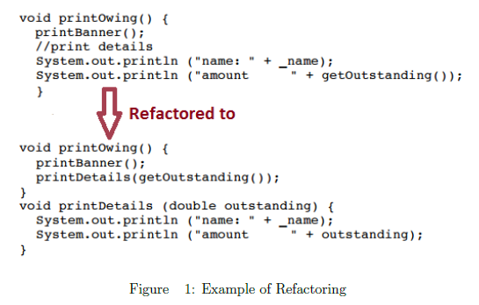
Implementation
Refactoring
Refactoring

Slide 49
Testing
Properties and Process
White Box Testing: source code
Black Box Testing: site re
Assessing Correctness
Testability

Slide 50
Deployment & Maintenance

Slide 51
Integration & Delivery

Slide 52
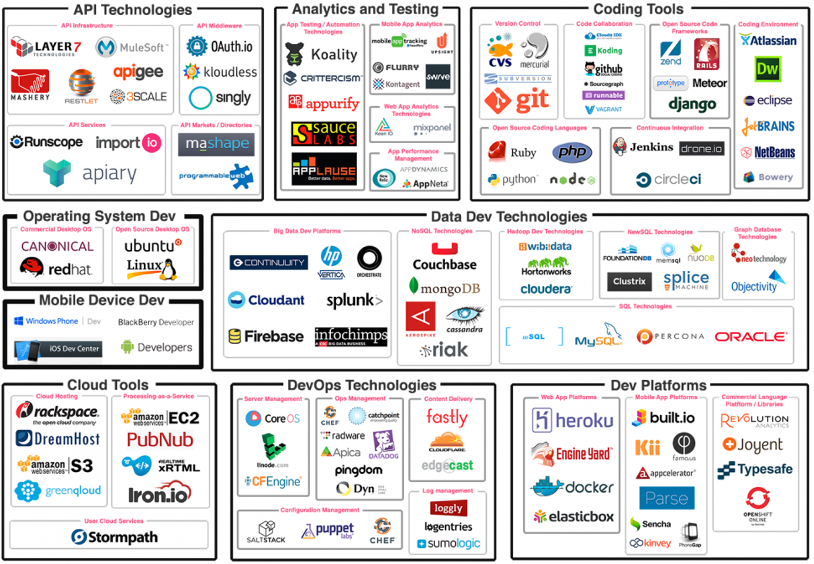

Slide 53
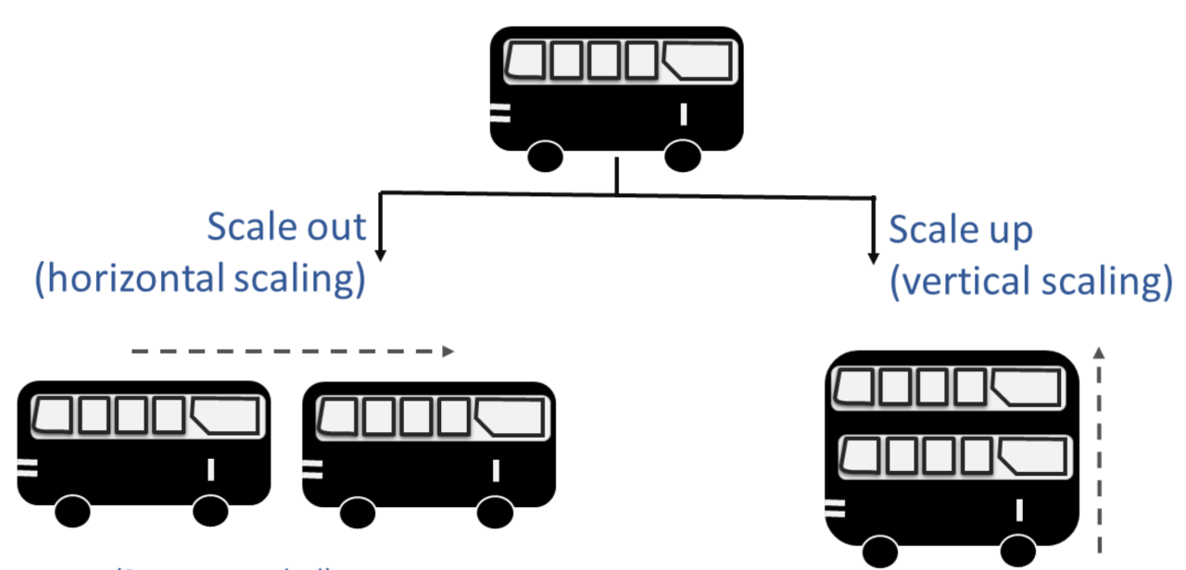
Integration & Delivery

Slide 54
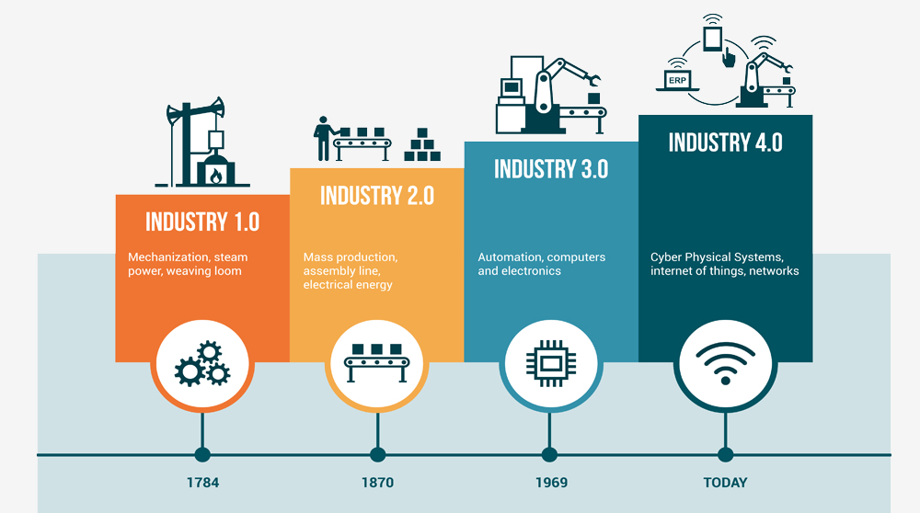
Introduction

